Slide 1
Excitation Table
In sequential circuit design, we need to know what inputs to apply to a flip-flop in order to cause a desired transition (from present state to next state).
That is exactly what the Excitation Table tells us.

Slide 2
Excitation Tables
J | K | Qt+1
0 | 0 | Qt
0 | 1 | 0
1 | 0 | 1
1 | 1 | Qt’
T | Qt+1
0 | Qt
1 | Qt’

Slide 3
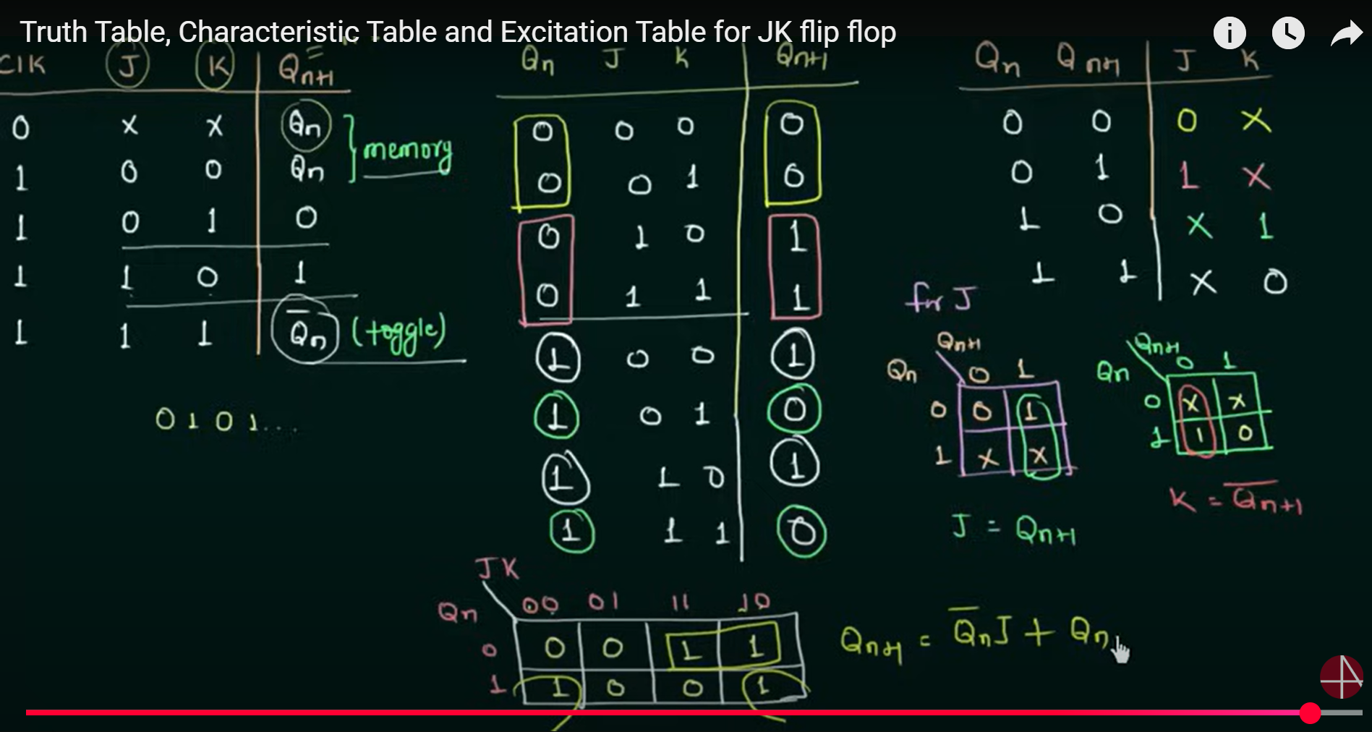

Slide 4
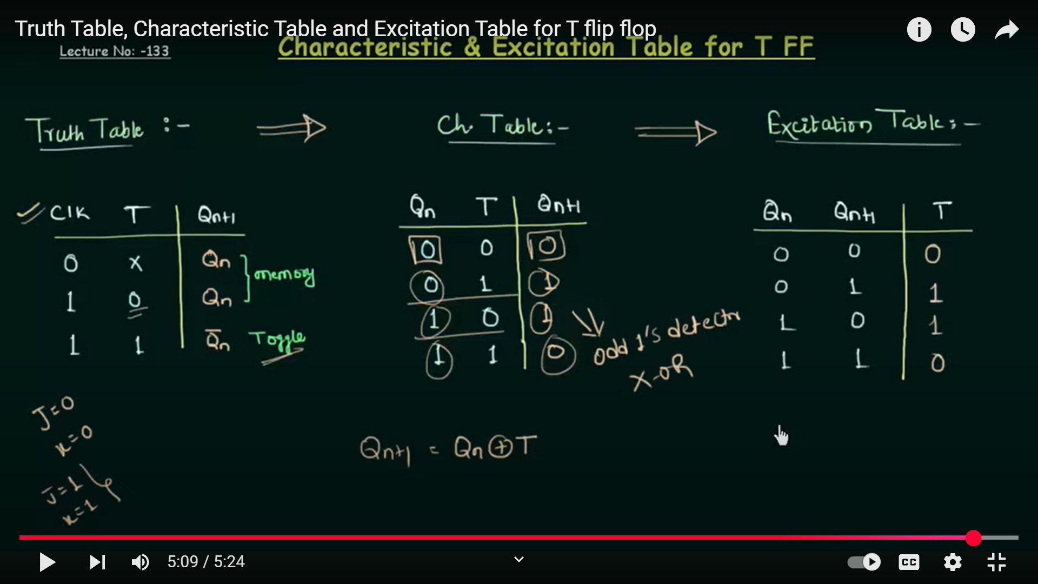

Slide 5
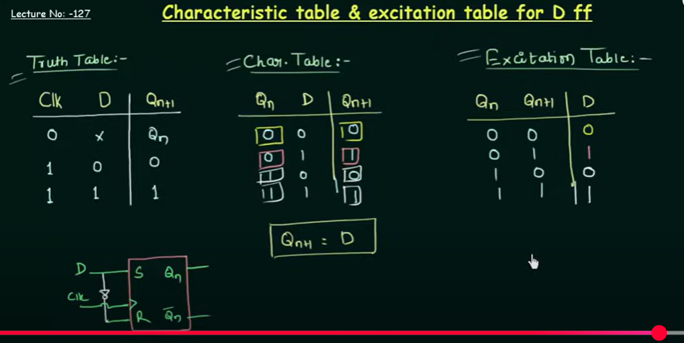

Slide 6
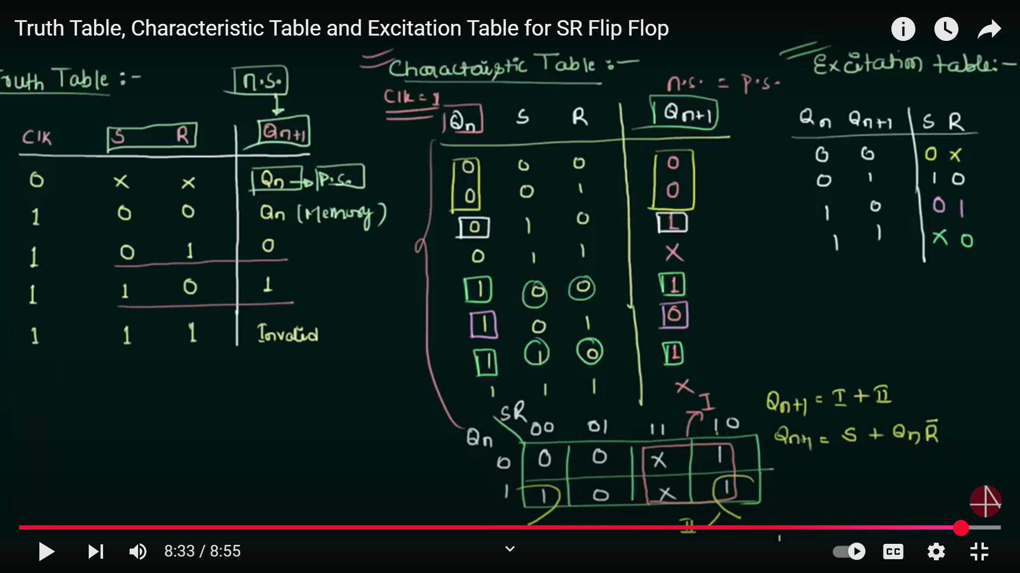

Slide 7
D | Qt+1
0 | 0
1 | 1
S | R | Qt+1
0 | 0 | Qt
0 | 1 | 0
1 | 0 | 1
1 | 1 | ?
(d) SR FF

Slide 8
Registers
A register is a group of flip‐flops, each one of which shares a common clock and is capable of storing one bit of information.
An n ‐bit register consists of a group of n flip‐flops capable of storing n bits of binary information. In addition to the flip‐flops, a register may have combinational gates that perform certain data‐processing tasks.
In its broadest definition, a register consists of a group of flip‐flops together with gates that affect their operation.
The flip‐flops hold the binary information, and the gates determine how the information is transferred into the register.

Slide 9
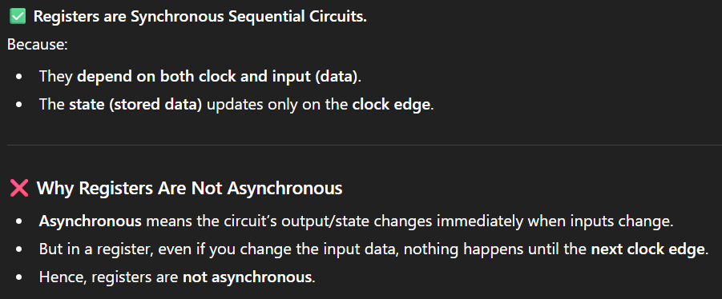

Slide 10
Shift Registers
The register is capable of shifting bits either towards right hand side or towards left hand side in a shift register.
An ‘N’ bit shift register contains ‘N’ flip-flops.
Following are the four types of shift registers based on applying inputs and accessing of outputs:
Serial In − Serial Out shift register (SISO)
Serial In − Parallel Out shift register (SIPO)
Parallel In − Serial Out shift register (PISO)
Parallel In − Parallel Out shift register (PIPO)
Type | Time behavior
SISO | Slowest (2n − 1 clocks)
SIPO | Medium speed
PISO | Medium speed
PIPO | Fastest (1 clock)

Slide 11
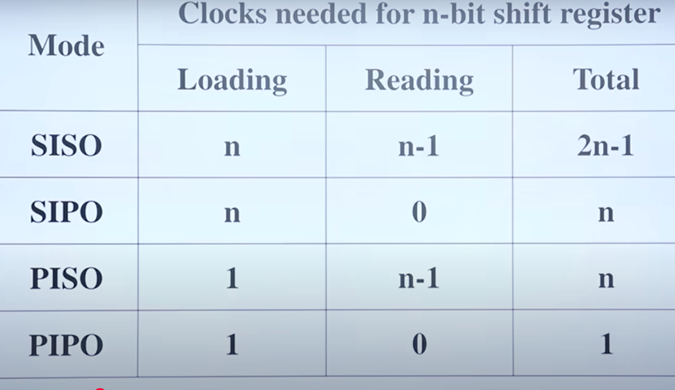

Slide 12
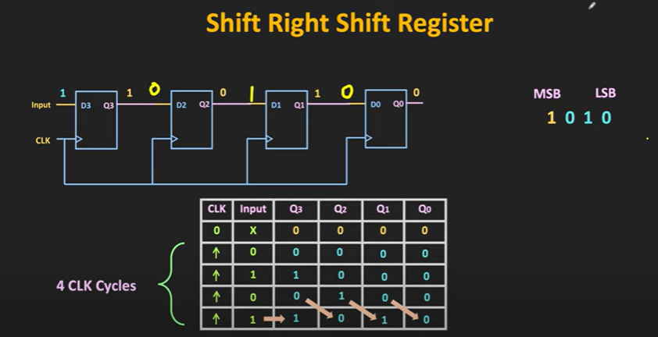
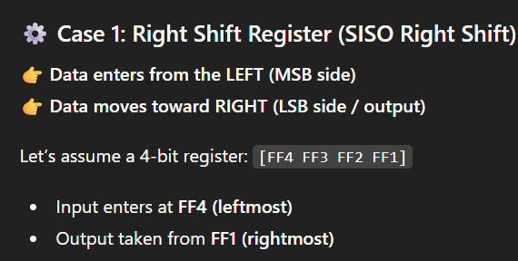
serial in serial out (right shift) Registers

Slide 13

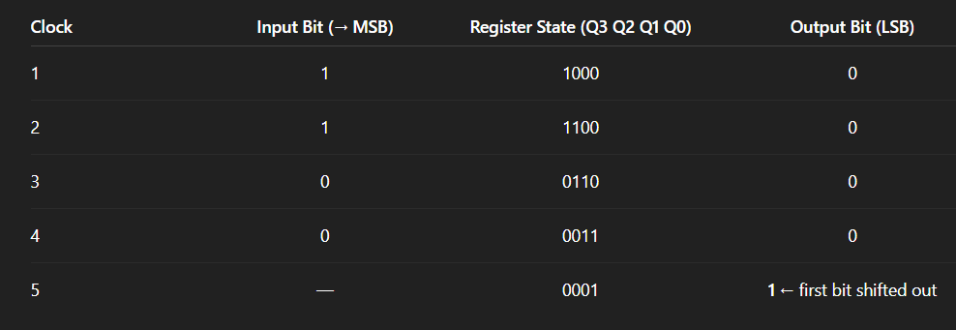
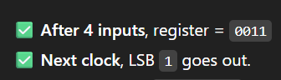

Slide 14
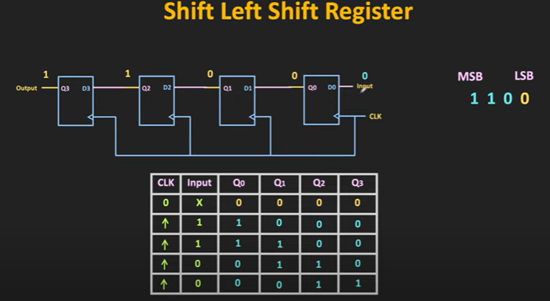
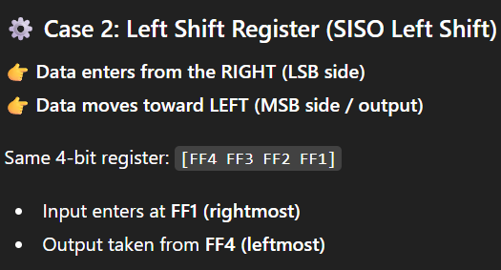

Slide 15
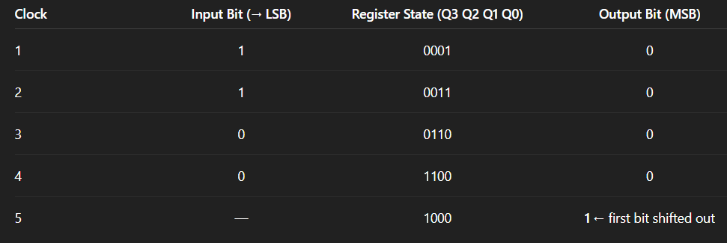


Slide 16
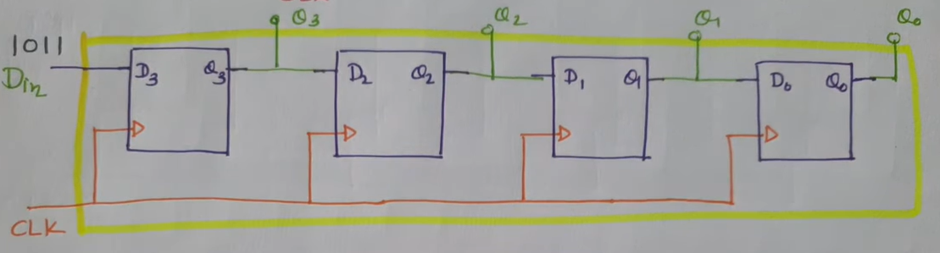
serial in parallel out Registers

Slide 17
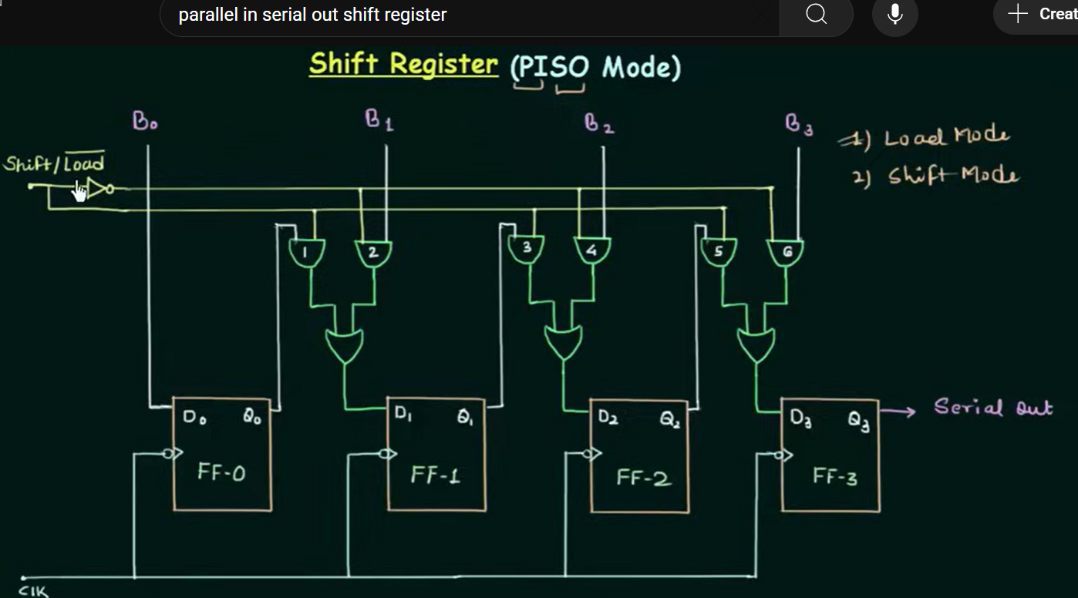
Parallel in serial out shift Registers

Slide 18
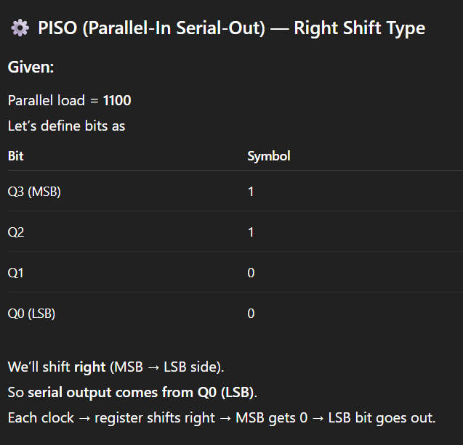

Slide 19
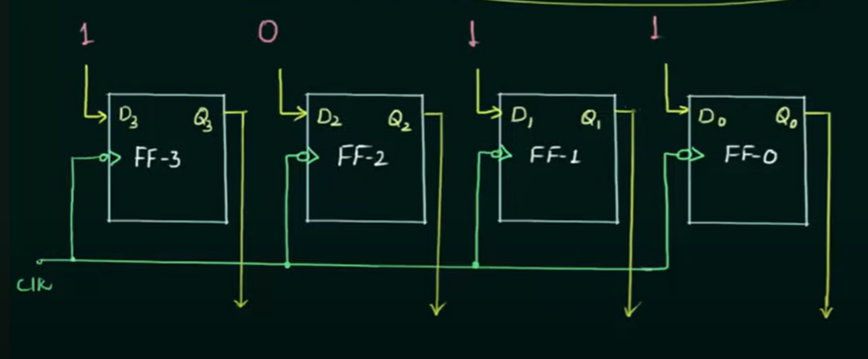
Parallel in parallel out shift Registers PIPO

Slide 20
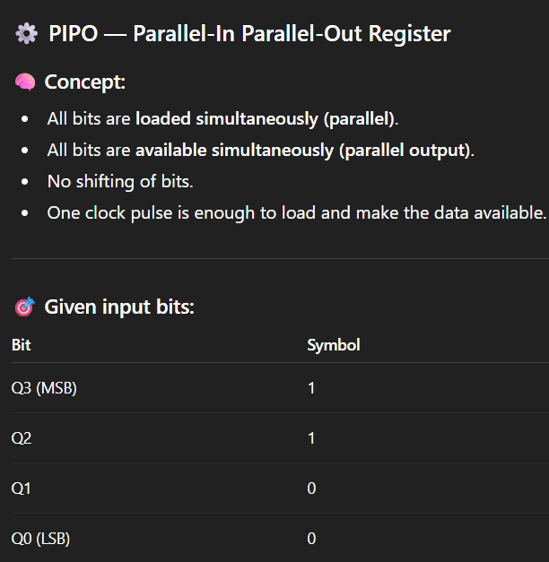

Slide 21
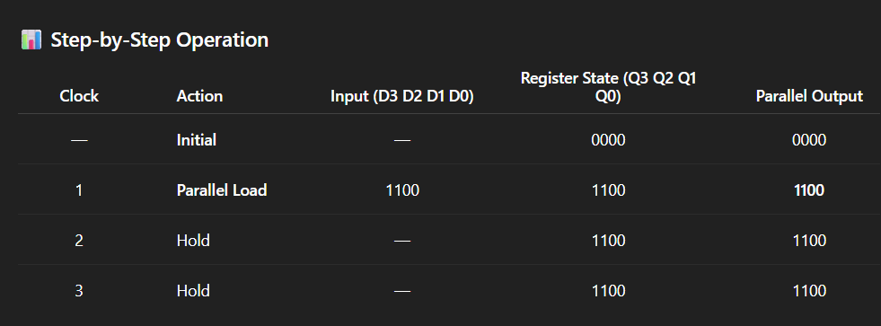

Slide 22
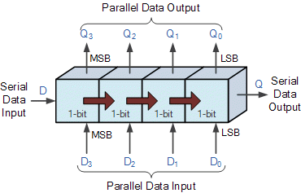
Shift Registers
The Shift Register is another type of sequential logic circuit that can be used for the storage or the transfer of binary data
In digital circuits, a shift register is a cascade of flip flops, sharing the same clock, in which the output of each flip-flop is connected to the "data" input of the next flip-flop in the chain, resulting in a circuit that shifts by one position the "bit array" stored in it, "shifting in" the data present at its input and 'shifting out' the last bit in the array, at each transition of the clock input.

Slide 23
Shift Register
A register capable of shifting in one direction only is a unidirectional shift register.
One that can shift in both directions is a bidirectional shift register.
If the register has both shifts and parallel‐load capabilities, it is referred to as a universal shift register.

Slide 24
Four‐bit universal shift register

Slide 25
The shift register has the following capabilities:
1. A clear control to clear the register to 0.
2. A clock input to synchronize the operations.
3. A shift‐right control to enable the shift‐right operation and the serial input and output lines associated with the shift right.
4. A shift‐left control to enable the shift‐left operation and the serial input and output lines associated with the shift left.
5. A parallel‐load control to enable a parallel transfer and the 4 input lines associated with the parallel transfer.
6. 4 parallel output lines.
7. A control state that leaves the information in the register unchanged in response to the clock. Other shift registers may have only some of the preceding functions, with at least one shift operation.

Slide 27
A Counter is a device which stores (and sometimes displays) the number of times a particular event or process has occurred, often in relationship to a clock signal. Counters are used in digital electronics for counting purpose, they can count specific event happening in the circuit.
Not only counting, a counter can follow the certain sequence based on our design like any random sequence 0,1,3,2… .They can also be designed with the help of flip flops

Slide 28
Shift Register Counters
A Shift Register Counter is basically a Shift Register with the serial output connected back to the serial input in order to produce Special Sequences.
These devices are often classified as counters, because they exhibit a specified sequence of states.
Two of the most common types of Shift Register Counters are
Twisted Ring Counter
Ring Counter

Slide 29
Ring Counter
Timing signals that control the sequence of operations in a digital system can be generated by a shift register or by a counter with a decoder. A ring counter is a circular shift register with only one flip‐flop being set at any particular time; all others are cleared. The single bit is shifted from one flip‐flop to the next to produce the sequence of timing signals.

Slide 30
This Figure shows a four‐bit shift register connected as a ring counter. The initial value of the register is 1000 which produces the variable T0. The single bit is shifted right with every clock pulse and circulates back from T3 to T0. Each flip‐flop is in the 1 state once every four clock cycles and produces one of the four timing signals Each output becomes a 1 after the negative‐edge transition of a clock pulse and remains 1 during the next clock cycle.

Slide 32
Timing Signals
Each flip-flop output (T0, T1, T2, T3) becomes 1 for exactly one clock cycle and then goes back to 0.
So we get four timing signals, each active once every four clock cycles.
This is useful for generating sequential timing (like in digital controllers or stepper motor drivers).

Slide 33
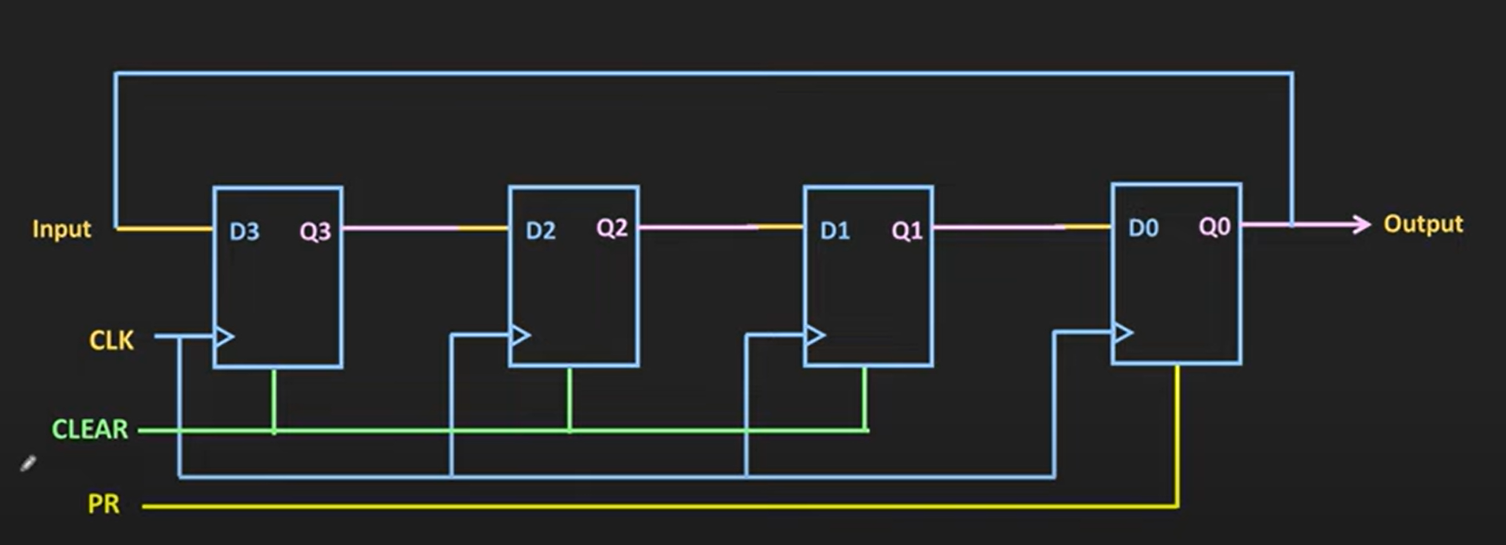
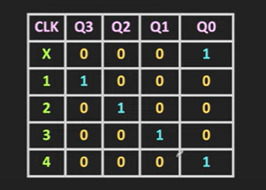
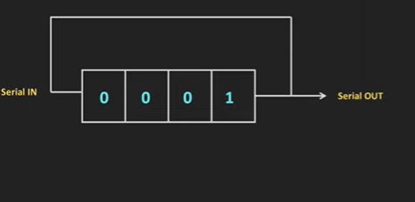
Ring Counter

Slide 34
For an alternative design, the timing signals can be generated by a two‐bit counter that goes through four distinct states and a decoder. The decoder decodes the four states of the counter and generates the required sequence of timing signals.
To generate 2^{n} timing signals, we need either a shift register with 2^{n} flip‐flops or an n ‐bit binary counter together with an n‐to‐2^{n} ‐line decoder.

Slide 35
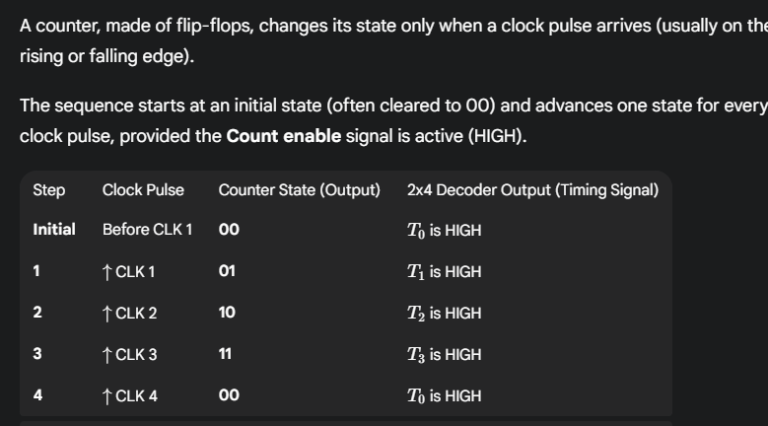

Slide 36
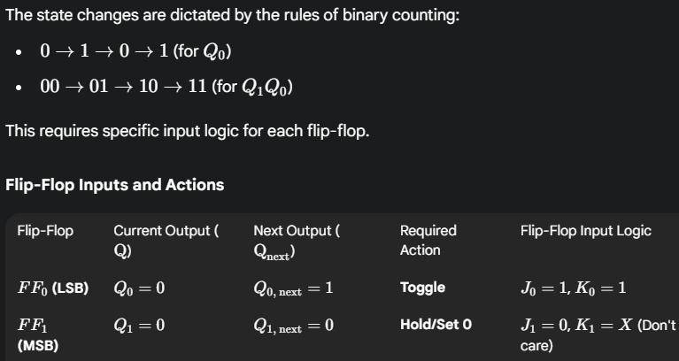

Slide 37
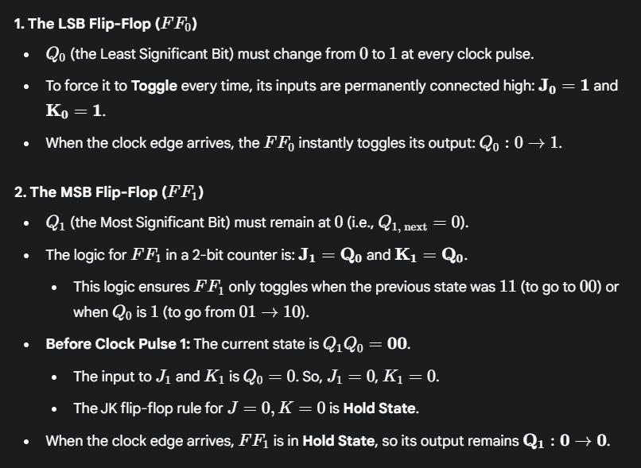

Slide 38
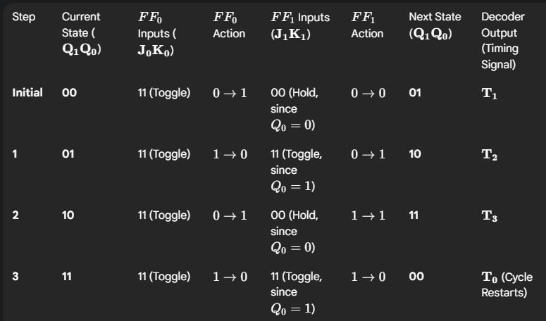

Slide 39
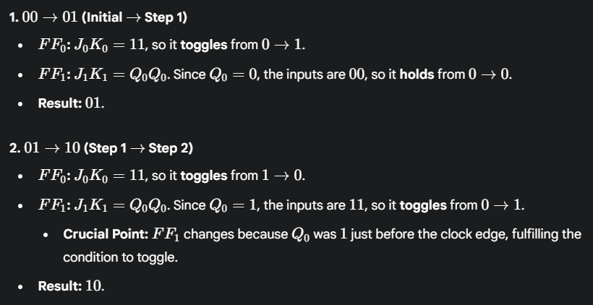
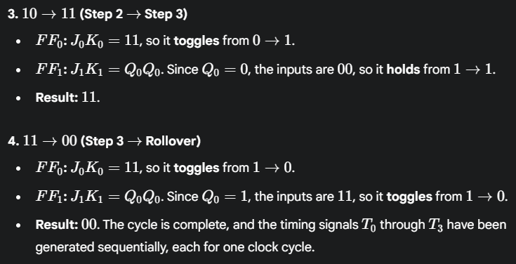

Slide 40
Johnson Counter
A Johnson Counter or a switch‐tail ring counter is a circular shift register with the complemented output of the last flip‐flop connected to the input of the first flip‐flop.

Slide 41
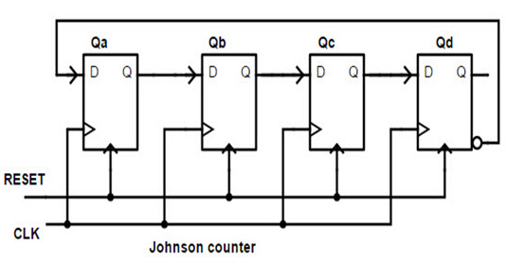
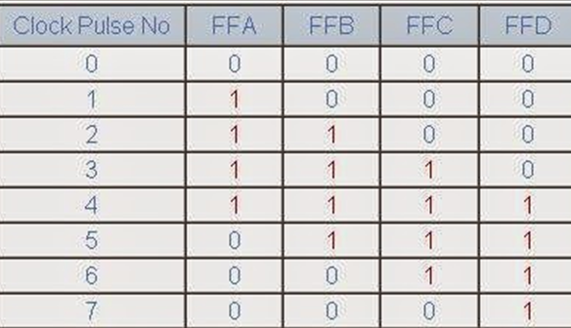
Johnson Counter (Twisted Ring Counter, Moebius Counter)

Slide 42
The decoding of a k ‐bit Johnson counter to obtain 2k timing signals follows a regular pattern. The all‐0’s state is decoded by taking the complement of the two extreme flip‐flop outputs. The all‐1’s state is decoded by taking the normal outputs of the two extreme flip‐flops. All other states are decoded from an adjacent 1, 0 or 0, 1 pattern in the sequence.
For example, sequence 7 has an adjacent 0, 1 pattern in flip‐flops B and C . The decoded output is then obtained by taking the complement of B and the normal output of C, or B’C.
Starting from a cleared state, the Johnson counter goes through a sequence of eight states. In general, a k ‐bit Johnson counter will go through a sequence of 2k states. Starting from all 0’s, each shift operation inserts 1’s from the left until the register is filled with all 1’s. In the next sequences, 0’s are inserted from the left until the register is again filled with all 0’s.
A k-bit Johnson counter with 2k decoding gates to provide 2k timing signals. The eight AND gates listed in the table, when
connected to the circuit, will complete the construction of the Johnson counter. Since each gate is enabled during one particular state sequence, the outputs of the gates generate eight timing signals in succession.

Slide 43
Ring Counter Recap
Needs n flip-flops → MOD-n counter.
Example: 4 flip-flops → 4 states (1000 → 0100 → 0010 → 0001).
Only 1 bit = 1 is circulated.
Limitation: To get many timing signals, you need the same number of flip-flops.
For 8 signals → 8 flip-flops.
Johnson Counter (Twisted Ring)
Feedback is taken from the inverted output of the last flip-flop and fed back to the first.
With n flip-flops → MOD-2n counter.
Example: With 4 flip-flops → 8 states:
0000 → 1000 → 1100 → 1110 → 1111 → 0111 → 0011 → 0001 → 0000
More states with fewer flip-flops
Ring counter: n FF → n states
Johnson counter: n FF → 2n states ✅ More efficient when many timing signals are needed

